Slide 1


DESIGN 1
Lesson 1: Project Launch: Design Specification and Site Map
Ms. Abboud • Grade 9 - Design 1 • Term 1, Week 10

Slide 2
Learning Objectives
WALT - We Are Learning To
WILF - What I'm Looking For
Understand the summative brief and rubric.
Plan my own website with a design specification and site map.
My site map has at least 4 pages with clear names.
My target audience is specific, not 'everyone'.

Slide 3
Academic Vocabulary
Design Specification
Target Audience
A written plan of what a product must do and include, used to judge if it succeeds.
The specific group of people a website is made for.
Site Map
Wireframe
A list or diagram of every page in a website and how they connect.
A simple sketch of a page layout showing what goes where, before coding.

Slide 4
Frayer Model: Target Audience
DEFINITION
CHARACTERISTICS
The specific group of people a website is designed for, whose needs shape every design decision.
A specific group; shapes design decisions; not 'everyone'.
TARGET AUDIENCE
EXAMPLES
NON-EXAMPLES
Grade 5 students learning about UAE desert animals.
'Anyone who might visit the internet.'

Slide 5
National Identity Integration
UAE Smart Government: UAE government websites are planned around the people who use them. Today you plan your own website for a specific audience, the same way.

Slide 6
STARTER
Who Is It For?
Look at two real websites made for very different people.
Who is each one for? How can you tell?
Hook • Engage & Ask
5 - 10 minutes

Slide 7
LESSON CORE
I Do: Your Summative Project
Build your OWN website: at least 4 pages, a menu, text, lists, images, a table and a form.
Week 10 plan and build, Week 11 form and feedback, Week 12 submit and present.
Gradual Release of Responsibility
30 - 40 minutes
1 / 3

Slide 8
LESSON CORE
We Do: Frayer and an Example Plan
Complete the Frayer Model for Target Audience.
Example: Desert animals of the UAE, for Grade 5 students. Pages: Home, Oryx, Falcon, Camel, Quiz.
Gradual Release of Responsibility
30 - 40 minutes
2 / 3

Slide 9
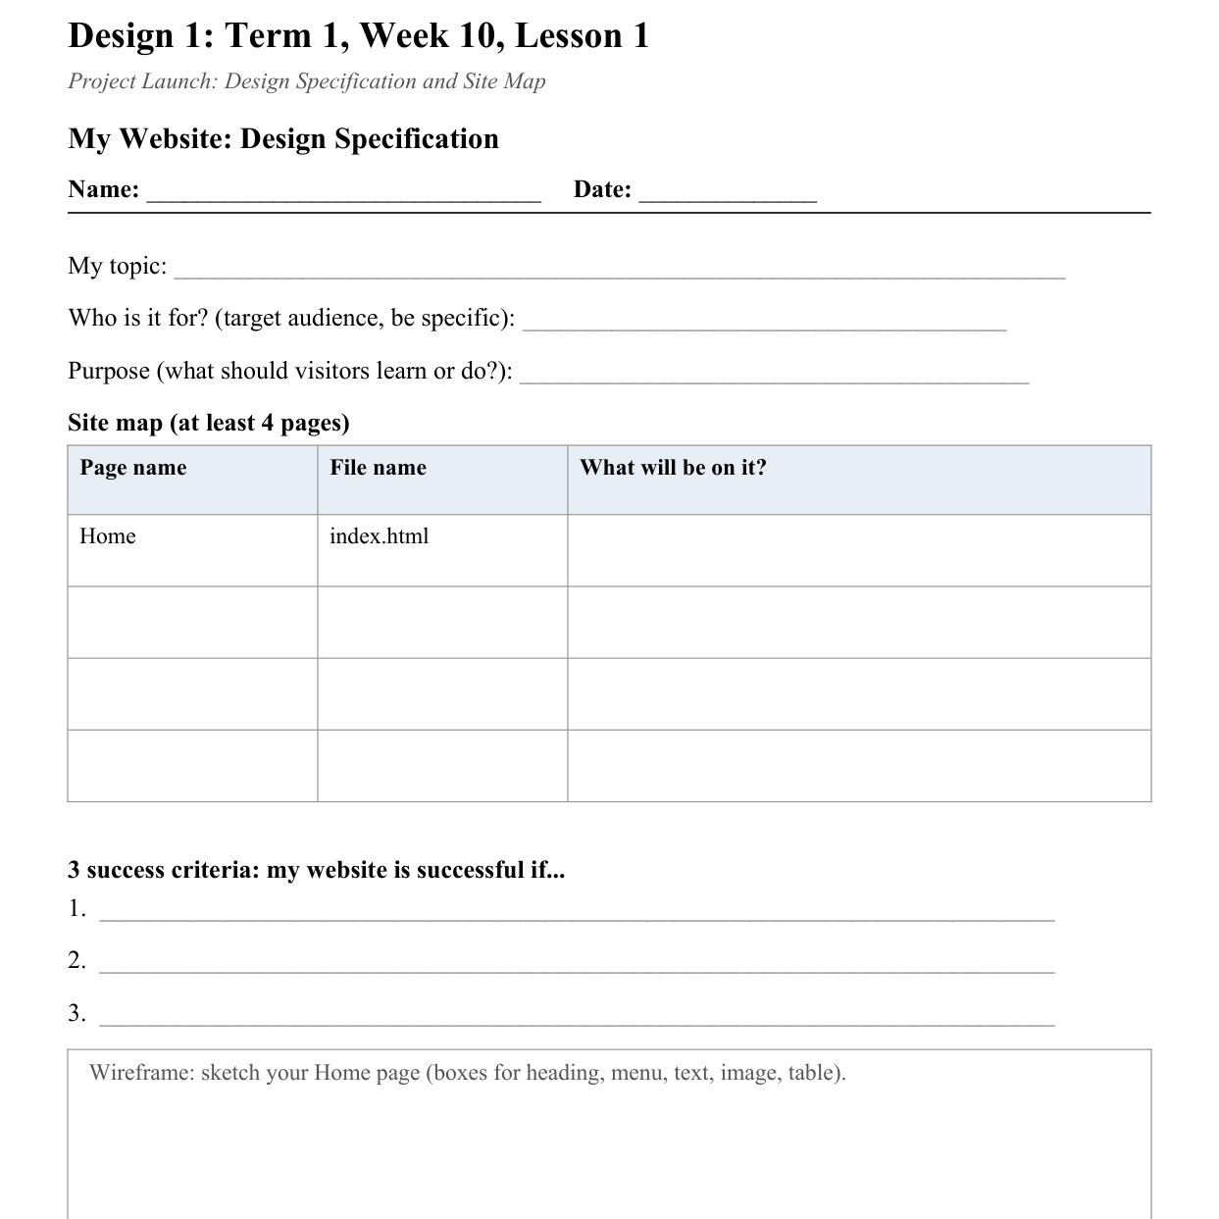
LESSON CORE
You Do: Write Your Design Specification
Choose your topic and audience.
Fill in the site map, 3 success criteria and a Home page wireframe.
Activity: Design Specification
Gradual Release of Responsibility
30 - 40 minutes
3 / 3

Slide 10
CLOSURE
Exit Ticket
Who is your website for, and what is one page they will find useful?
Transition & Extend
5 - 10 minutes

